Slide 1
Review: for-loop vs. while-loop
In general:
for-loop: Repeat a task a finite number of times
while-Loop: Repeat a task indefinitely until a condition is met
Consider the Loop start and end cases.
init;
while (condition){
statement1-n;
update;
}
statement2;
for (init; condition; update){
statement1-n;
}
statement2;

Slide 2
Looping (III) Nested Loops

Slide 3
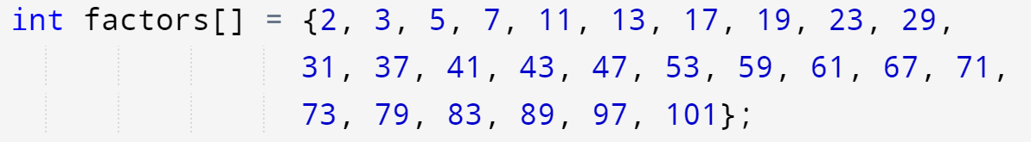
Lab 6 Ex4, Prime or composite?
Lab 7 again!
Composite number x,
find one i, x%factors[i]==0
and x>factors[i]
Prime number x
for all i, x%factors[i]!=0
but all factors[i] should be < x
Flag
Break/Continue
(Next week)

Slide 4
Outline
Flag
Nested Loops
– A loop inside another loop
2-D array
Pattern printing
Brute-force search

Slide 5
Motivation
In our previous lectures, we have learned how to use while loop and for loop.
We now move to more advanced usage of loops.
Loops are VERY IMPORTANT as they enable solutions and algorithms for many problems.

Slide 6
Lab 6 Ex4, Prime or composite?
Lab 7 again!
Composite number x,
find one i, x%factors[i]==0
and x>factors[i]
Prime number x
for all i, x%factors[i]!=0
but all factors[i] should be < x
Flag

Slide 7
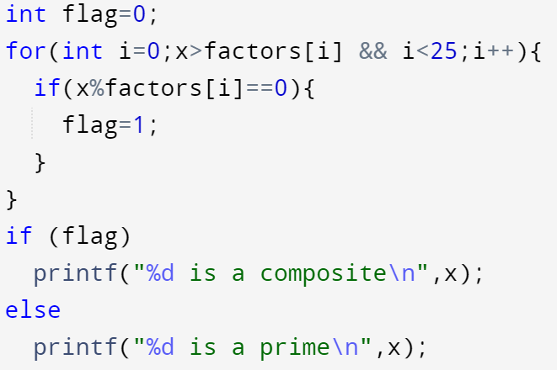
Flag: Lab 6 Ex4, Prime or composite?
Lab 7 again!
Before the Loop
0 is Prime(Default)
Inside the Loop
if … set flag as 1,
composite
After the loop
1 -> Composite
0 -> Prime

Slide 8
1. Flage
Flag
One more variable flag to mark different situations in the loop
E.g., Lab 6 Ex4, Prime or composite?
Before the Loop
int flag=0 // -> 0 is prime, 1 is composite
Inside the Loop
if we find any x%factors[i]==0, set flag=1
Mark as a composite number
After the loop
we can easily use if flag==0/1 to output prime / composite
Think about
“count”

Slide 9
Outline
Flag
Nested Loops
– loops inside other loops
2-D array
Pattern printing
Brute-force search

Slide 10
2. Nested Loops – A Loop Inside Another Loop
1 1
1 2
1 3
1 4
2 1
2 2
2 3
2 4
3 1
3 2
3 3
3 4
1
2
3
4
5
6
int i, j;
for (i = 1; i <= 3; i++) {
for (j = 1; j <= 4; j++) {
printf("%d %d\n", i, j);
}
}
i = 1
i = 2
For each outer loop iteration, the inner loop iterates for 4 times.
Total # of printf() = 3 * 4 = 12 times
i = 3
↑
i
↑
j

Slide 11
2. Nested Loops – A Loop Inside Another Loop
1 1
1 2
1 3
1 4
2 1
2 2
2 3
2 4
3 1
3 2
3 3
3 4
1
2
3
4
5
6
int i, j;
for (i = 1; i <= 3; i++) {
for (j = 1; j <= 4; j++) {
printf("%d %d\n", i, j);
}
}
i = 1
i = 2
The whole loop is considered as only ONE statement
We can delete the brace {}
i.e. no semi-colon (;) required in line 2 & 3
i = 3
↑
i
↑
j

Slide 12

2.0. Nested Loop Common Mistakes
Always use a different looping variables in each layer of nested loops
By convention we often use $i, j$ and $k$
What happens if you mistakenly use the same index for different layers of a nested loop? Check out a modified Example #1 below:
int i, j;
for (i = 1; i <= 3; i++) {
for (i = 1; i <= 4; i++) {
printf("%d ", i);
}
}
Can you dry run the program to see the expected output?
Ureply

Slide 13
2.1. Outer Loop and Inner Loop(s)
A nested loop always has an outer loop and one or more inner loops
Assuming a simple nested loop of 2 levels
Outer loop represents repetition at the topmost level
The inner loop represents a repetition that repeats in every outer loop

Slide 14
2.1. Outer Loop and Inner Loop(s)
A good example would be your university life, which involves nested repetition:
You will likely study for 4 years
Each year you will have 2 semesters (simplified)
Each semester you will have 13 weeks of study (simplified)
Question: Which one of them is the outer loop? Inner loop(s)?
From lager to smaller, outer to inner

Slide 15
2.1. Outer Loop and Inner Loop(s)
1
2
3
4
5
6
7
8
9
10
int year, sem, week;
for (year = 1; year <= 4; year++) {
printf("Year %d\n", year);
}
The outer loop is obviously the 4 years you will spend in the university. In the example above, we model your 4 years of university life in C.
Year 1
Year 2
Year 3
Year 4

Slide 16
2.1. Outer Loop and Inner Loop(s)
1
2
3
4
5
6
7
8
9
10
int year, sem, week;
for (year = 1; year <= 4; year++) {
for (sem = 1; sem <= 2; sem++) {
printf("Year %d sem %d\n", year, sem);
}
}
In each year, you will have 2 semesters. So the repetitions of semester is modelled by the inner loop here.
How is the code executed?
How is the loop jumping/running?
for (year = 1; year <= 4; year++) {
printf("Year %d\n", year);
for (sem = 1; sem <= 2; sem++) {
printf(“\t sem %d\n", sem);
}
}
Year 1 sem 1
Year 1 sem 2
Year 2 sem 1
Year 2 sem 2
Year 3 sem 1
Year 3 sem 2
Year 4 sem 1
Year 4 sem 2

Slide 17
2.1. Outer Loop and Inner Loop(s)
1
2
3
4
5
6
7
8
9
10
int year, sem, week;
for (year = 1; year <= 4; year++) {
for (sem = 1; sem <= 2; sem++) {
for (week = 1; week <= 13; week++) {
printf("Year %d sem %d week %d\n",year,sem,week);
}
}
}
If we go further, we have roughly 13 weeks in each semester. So we can have a further inner loop to the semester loop. This makes our nested loop a 3-layer one.
Year 1 sem 1 week 1
Year 1 sem 1 week 2
...
Year 1 sem 1 week 13
Year 1 sem 2 week 1
Year 1 sem 2 week 2
...

Slide 18
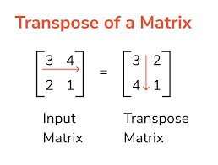

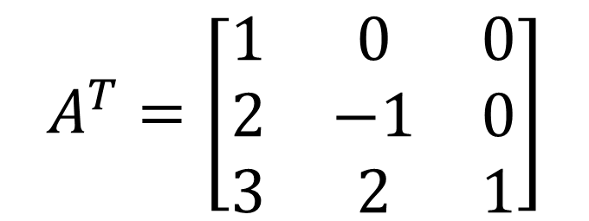
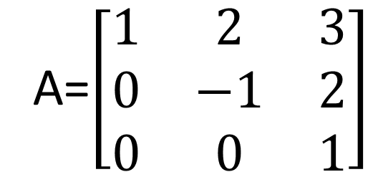
2.2. Nested Loops (Example #1)
Example: Using a nested loop to handle a 2D array
A=$\left[\begin{matrix}1 & 2 & 3 \\ 0 & −1 & 2 \\ 0 & 0 & 1\end{matrix}\right]$
$$A^{T}=\left[\begin{matrix}1 & 0 & 0 \\ 2 & −1 & 0 \\ 3 & 2 & 1\end{matrix}\right]$$
Matrix:
In General
outer is for row
inner for column
$A^{T}$[i][j] = A[j][i];

Slide 19
2.2. Nested Loops (Example #1)
1
2
3
4
5
6
7
8
9
10
11
12
13
14
15
16
17
18
19
20
// A and B represent two 3x3 matrices
int A[3][3] = { { 1, 2, 3 }, { 0, -1, 2 }, { 0, 0, 1 } };
int B[3][3]; // To store the transpose of matrix A
int i, j;
// Store transpose of A in B
for (i = 0; i < 3; i++)
for (j = 0; j < 3; j++)
B[i][j] = A[j][i];
// Print matrix A
for (i = 0; i < 3; i++) {
for (j = 0; j < 3; j++)
printf("%4d", A[i][j]);
printf("\n");
}
printf("\n");
// Repeat the above for-loop for matrix B
...
Example: Using a nested loop to handle a 2D array
1 2 3
0 -1 2
0 0 1
1 0 0
2 -1 0
3 2 1

Slide 20
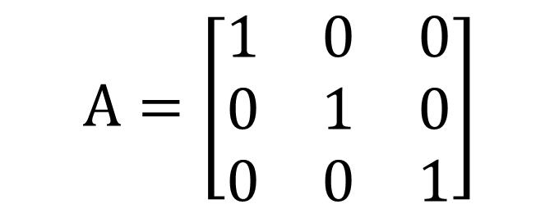
2.2. Nested Loops (Example #)
Example: Using a nested loop to handle a 2D array
Hints:
A[i][i]==1
All other ==0
Need Flag?
Practice by yourself
$$A=\left[\begin{matrix}1 & 0 & 0 \\ 0 & 1 & 0 \\ 0 & 0 & 1\end{matrix}\right]$$
Identity matrix:
Given a matrix A[][],
Output Identity matrix or not

Slide 21
2.3. Nested Loops (Example #2)
Objective: Given a positive integer N, output a triangle in the following format (e.g., when N = 5):
*
**
***
****
*****
N rows
In General
outer is for row
inner for column
There are 5 rows (outer loop)
Each row contains * (inner loop)
N columns

Slide 22
2.3. Nested Loops (Example #2)
*
**
***
****
*****
1
2
3
4
5
6
7
8
9
10
11
int i, j, N;
printf("N = ? ");
scanf("%d", &N);
for (i = 1; i <= N; i++) { // N rows
}
N rows
To write a nested loop, we first need to consider what constitutes our outer loop.
In this example problem, we need to print a total of N lines, so an outer loop to count for N times would be good.
In General
outer is for row
inner for column

Slide 23

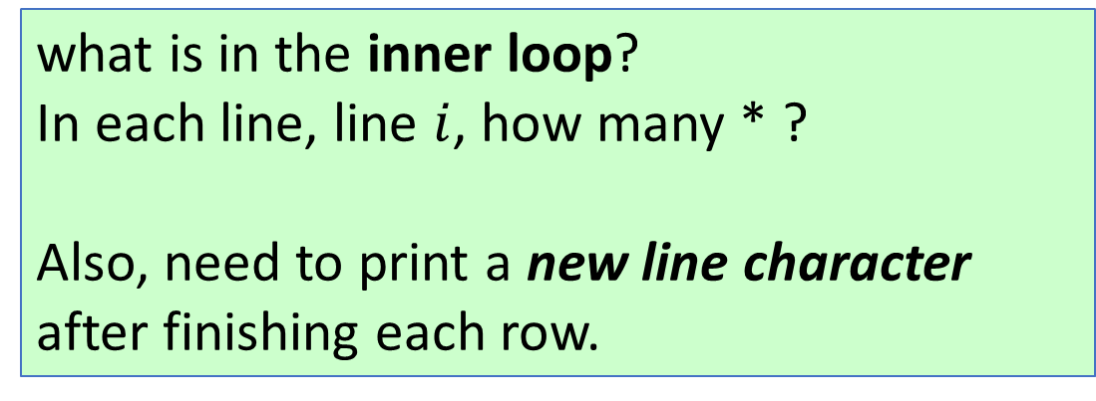
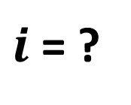
2.3. Nested Loops (Example #2)
*
**
***
****
*****
1
2
3
4
5
6
7
8
9
10
11
int i, j, N;
printf("N = ? ");
scanf("%d", &N);
for (i = 1; i <= N; i++) { // N rows
// Step 1: print i number of stars
// i.e. 1 star in line 1, 2 stars in line 2... etc.
// Step 2: print a new line character
}
N = 5
$i$= ?
what is in the inner loop?
In each line, line $i$, how many * ?
Also, need to print a new line character after finishing each row.
Relationship between $i$ and output

Slide 24
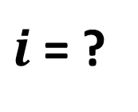
2.3. Nested Loops (Example #2)
*
**
***
****
*****
1
2
3
4
5
6
7
8
9
10
11
int i, j, N;
printf("N = ? ");
scanf("%d", &N);
for (i = 1; i <= N; i++) { // N rows
for (j = 1; j <= i; j++) {// row #i has i stars
printf("*");
}
printf("\n");
}
N = 5
$i$= ?
This is already the solution.
For beginners, always make sure you plan for the outer loop and inner loop before you start writing your code or pseudocode.
N = ? 6
*
**
***
****
*****
******

Slide 25
2.3.0 Nested Loop Common Mistakes
Be aware of the placement of new lines
Indentation and relationship between loops
Brace { }
int i, j;
for (i = 1; i <= 3; i++) {
for (j = 1; j <= i; j++) {
printf("*");
}
}
printf("\n");
When should the output finish printing a line?
for (i = 1; i <= 3; i++)
for (j = 1; j <= i; j++) {
...
}
} // where does this } come from??

Slide 26

2.3. Nested Loops (Example #)
Objective: Given a positive integer N, output a triangle in the following format (e.g., when N = 5):
*
***
*****
*******
*********
How about this one?
Relationship between $i$ (row number) and number of space and *
Practice by yourself
N = 5
N rows
??? columns
There are 5 rows (outer loop)
Each row contains space ‘ ‘ and ‘*’ (inner loop), how many columns?

Slide 27
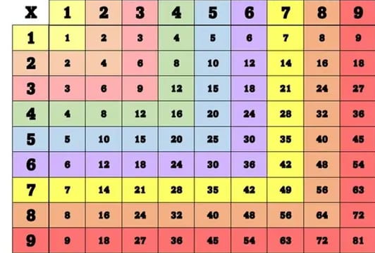
2.4. Nested Loops (Example #3)
Objective: To output a multiplication table in the following format:
1 2 3 4 5 6 7 8 9
2 4 6 8 10 12 14 16 18
......
9 18 27 36 45 54 63 72 81
9 rows
What are the things being repeated?
There are 9 rows (outer loop)
Each row contains 9 numbers (inner loop)

Slide 28
2.4. Nested Loops (Example #3)
What expression, in terms of i and j, will yield the numbers we need?
1 2 3 4 5 6 7 8 9
2 4 6 8 10 12 14 16 18
......
9 18 27 36 45 54 63 72 81
1
2
3
4
5
6
7
8
9
int i, j;
for (i = 1; i <= 9; i++) { // 9 rows
for (j = 1; j <= 9; j++) { // 9 numbers per row
printf("%d ", ______________);
}
printf("\n"); // Newline appears only once per row
}
Ureply

Slide 29
2.4. Nested Loops (Example #3)
Outer loop -> i -> row
Inner loop -> j -> column
M[i][j] = ?
Relationship between output value and i and j

Slide 30
2.5. Three level Nested Loops (Example #4)
Objective: To find all sets of integers that satisfy the following equality:
x² + y² + z² = 1000000, 0 ≤ x, y, z ≤ 1000
Brute-force search (暴力搜索)
One possible (quick and dirty) solution
try all possible values for x, y, and z.
Another example:
Find factors
Try all possible values

Slide 31
2.5. Three level Nested Loops (Example #4)
1
2
3
4
5
6
7
8
9
10
int x, y, z;
for (x = 0; x <= 1000; x++) {
for (y = 0; y <= 1000; y++) {
for (z = 0; z <= 1000; z++) {
if (x*x + y*y + z*z == 1000000)
printf("%d, %d, %d\n", x, y, z);
}
}
}
Brute-force search: try all possible solutions

Slide 32
2.6. Nested Loop Common Mistakes
Always use a different looping variables in each layer of nested loops
By convention we often use $i, j$ and $k$
What happens if you mistakenly use the same index for different layers of a nested loop? Check out a modified Example #1 below:
int i, j;
for (i = 1; i <= 3; i++) {
for (i = 1; i <= 4; i++) {
printf("%d ", i);
}
}
Can you dry run the program to see the expected output?

Slide 33
2.6. Nested Loop Common Mistakes
Be aware of the placement of new lines
Indentation and relationship between loops
Brace { }
int i, j;
for (i = 1; i <= 3; i++) {
for (j = 1; j <= i; j++) {
printf("*");
}
}
printf("\n");
When should the output finish printing a line?
for (i = 1; i <= 3; i++)
for (j = 1; j <= i; j++) {
...
}
} // where does this } come from??

Slide 34
Lab 7 Hints: Due: Next Wed
Ex3: Nested Loop, Row and Column
Ex4: Prime again (inner Loop), add Outer Loop
Ex5: refer to Lab7 Ex2, given pseudocode (偽代碼)
change code a little bit
Ex6: Moving average of order K
1 2 3 4 5 6 7 8
Avg = 2.0
3.0
4.0

